Slide 1
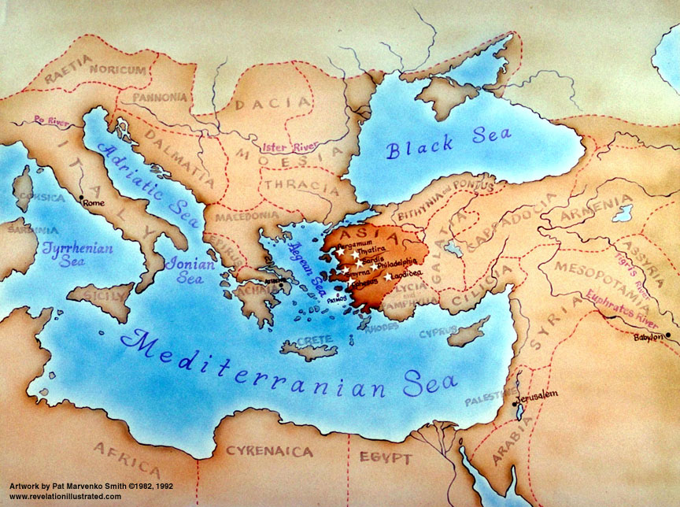
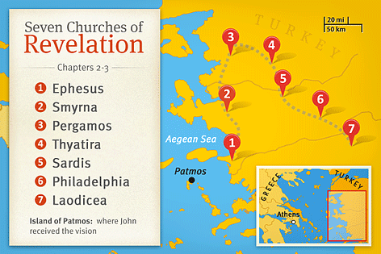

Slide 2
Revelation 2:12-17

Slide 3
¹² “And to the angel of the church in Pergamum write: ‘The words of him who has the sharp two-edged sword.
¹³ “ ‘I know where you dwell, where Satan’s throne is. Yet you hold fast my name, and you did not deny my faith even in the days of Antipas my faithful witness, who was killed among you, where Satan dwells. ¹⁴ But I have a few things against you: you have some there who hold the teaching of Balaam, who taught Balak to put a stumbling block before the sons of Israel, so that they might eat food sacrificed to idols and practice sexual immorality.

Slide 4
¹⁵ So also you have some who hold the teaching of the Nicolaitans. ¹⁶ Therefore repent. If not, I will come to you soon and war against them with the sword of my mouth. ¹⁷ He who has an ear, let him hear what the Spirit says to the churches. To the one who conquers I will give some of the hidden manna, and I will give him a white stone, with a new name written on the stone that no one knows except the one who receives it.’

Slide 5
The Pergamum Church – Faithful – but Compromising
‘The words of him who has the sharp two-edged sword
^{Ephesians 6:17} and take the helmet of salvation, and the sword of the Spirit, which is the word of God,
^{Hebrews 4:12} For the word of God is living and active, sharper than any two-edged sword, piercing to the division of soul and of spirit, of joints and of marrow, and discerning the thoughts and intentions of the heart. ¹³ And no creature is hidden from his sight, but all are naked and exposed to the eyes of him to whom we must give account.

Slide 6
The Pergamum Church – Faithful – but Compromising
Jesus’ words are the words of God Himself, and His words cut deep. Power and authority to judge.
The Reason why Jesus’ words are so cutting:
To leave no doubt how critical it is, to repent of sin
This is not the final judgment – it is a warning to repent before the time of judgment comes.
¹³ “ ‘I know where you dwell, where Satan’s throne is. Yet you hold fast my name, and you did not deny my faith even in the days of Antipas my faithful witness, who was killed among you, where Satan dwells.
Pergamum was the center for “emperor worship”
At least one died rather than worship Caesar. (Antipas)
To worship any other god, is to worship Satan

Slide 7
¹⁴ But I have a few things against you: you have some there who hold the teaching of Balaam, who taught Balak to put a stumbling block before the sons of Israel, so that they might eat food sacrificed to idols and practice sexual immorality.
False teachers – a subtle temptation to assimilate with society
Dabbling in the worship of idols (eating sacrificial meat)
The practice of sexual immorality
Fornication (pre-marital sex); prostitution; other ... ; Spiritual unfaithfulness (worshipping other Gods)

Slide 8
¹⁴ But I have a few things against you: you have some there who hold the teaching of Balaam, who taught Balak to put a stumbling block before the sons of Israel, so that they might eat food sacrificed to idols and practice sexual immorality.
False teachers – a subtle temptation to assimilate with society
Dabbling in the worship of idols (eating sacrificial meat)
The practice of sexual immorality
The example of Balaam (Numbers 22-24, 25, 31)
He appeared to be a man of God, but he was working against God
Brought in compromise. The men of Israel tempted into sexual immorality with women of other nations and then led to worshipping other gods

Slide 9
Jesus’ words are so cutting, to leave no doubt how critical it is to repent of sin before judgment comes
Pergamum congratulated for not denying Jesus when threatened with persecution and death
To worship any other god, is to worship Satan
False teachers – a subtle temptation to assimilate with society
Dabbling in the worship of idols (eating sacrificial meat)
The practice of sexual immorality
False teachers are most dangerous when they seem Godly and gifted, but subtly introduce compromise into a church
Those who don’t repent – judged
Those who do repent: Forgiveness and eternal life and blessing
Hidden Manna – sustenance from God (eternal provision)
White Stone – white is the colour of holiness
New Name – new identity in Christ. No longer who we once were

